Slide 1
AIR TRAFIC CONTROL AND TICKET MANAGEMENT SYSTEM
Rakibul Hasan
ID :CE – 16037
Dept. of CSE
MBSTU
Submitted To :
Md Mezbahul Islam
Lecturer
Department Of Computer Science And Engineering
Mawlana Bhashani Science And Technology

Slide 2
Purpose Of The Application
Passenger can book ticket easily both international and domestic from this system .
Admin can easily control the whole system. Like add the new information of plane, update the information and delete the information .

Slide 3
Feature Of The Application :
Ticket management system .
Information of the passenger . Like name , C/O, Photo
For international travel needs passport number.
List of available plane will be shown.
List of available seat of the selected plane.
Total cost .

Slide 4
Air traffic control.
Admin of the system can easily add new information of plane . Like plane name, arrival time , departure time, destination , number of available seat, cost.
Update information of available plane.
Delete the information of the plane .

Slide 5
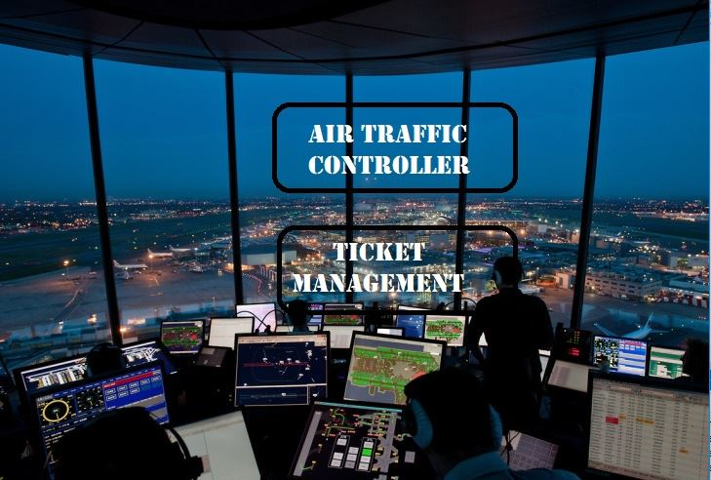
Option Menu :

Slide 6
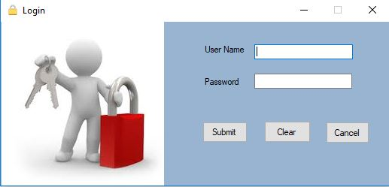
Login Menu :

Slide 7
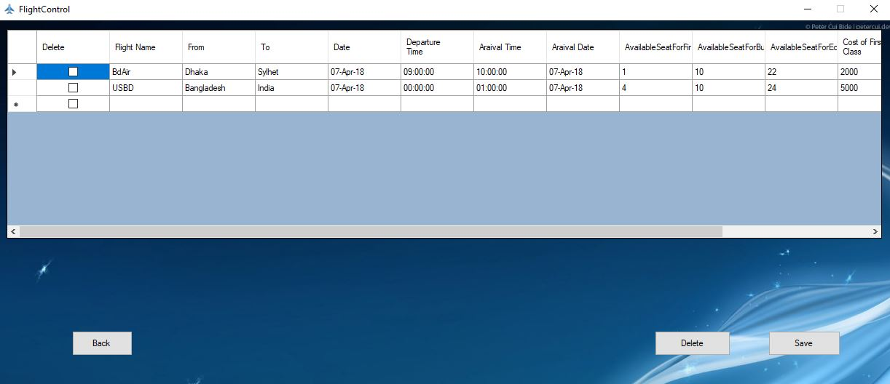
Flight Control Frame :

Slide 8
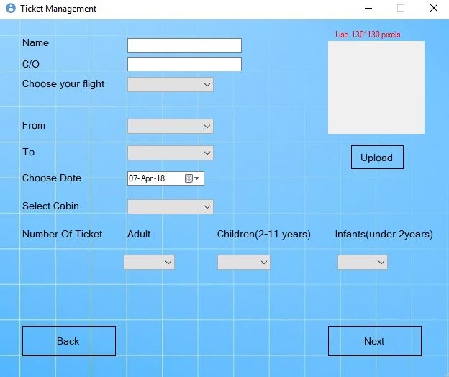
Ticket Management System :

Slide 9
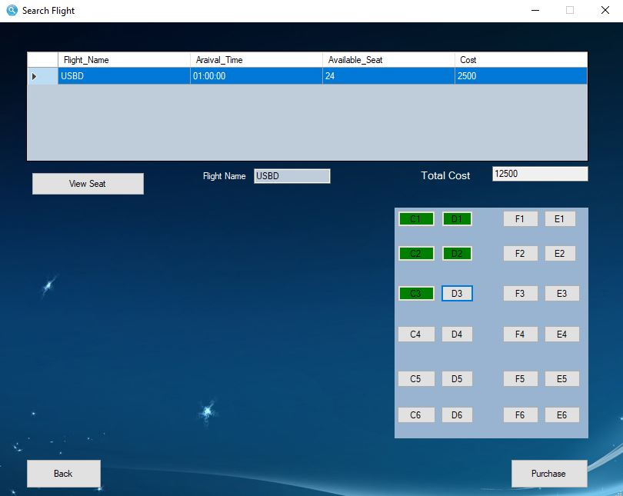
Search Flight :

Slide 10
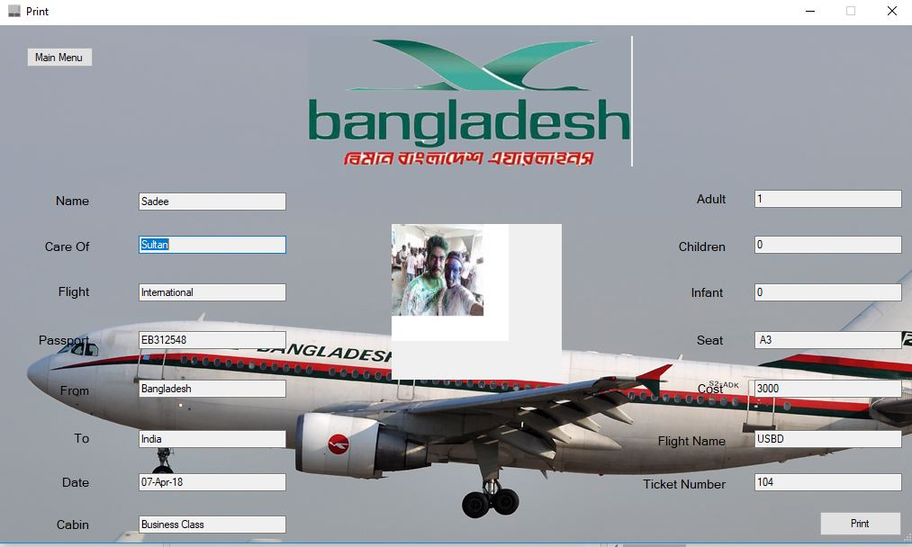
Print Page :

